Slide 1
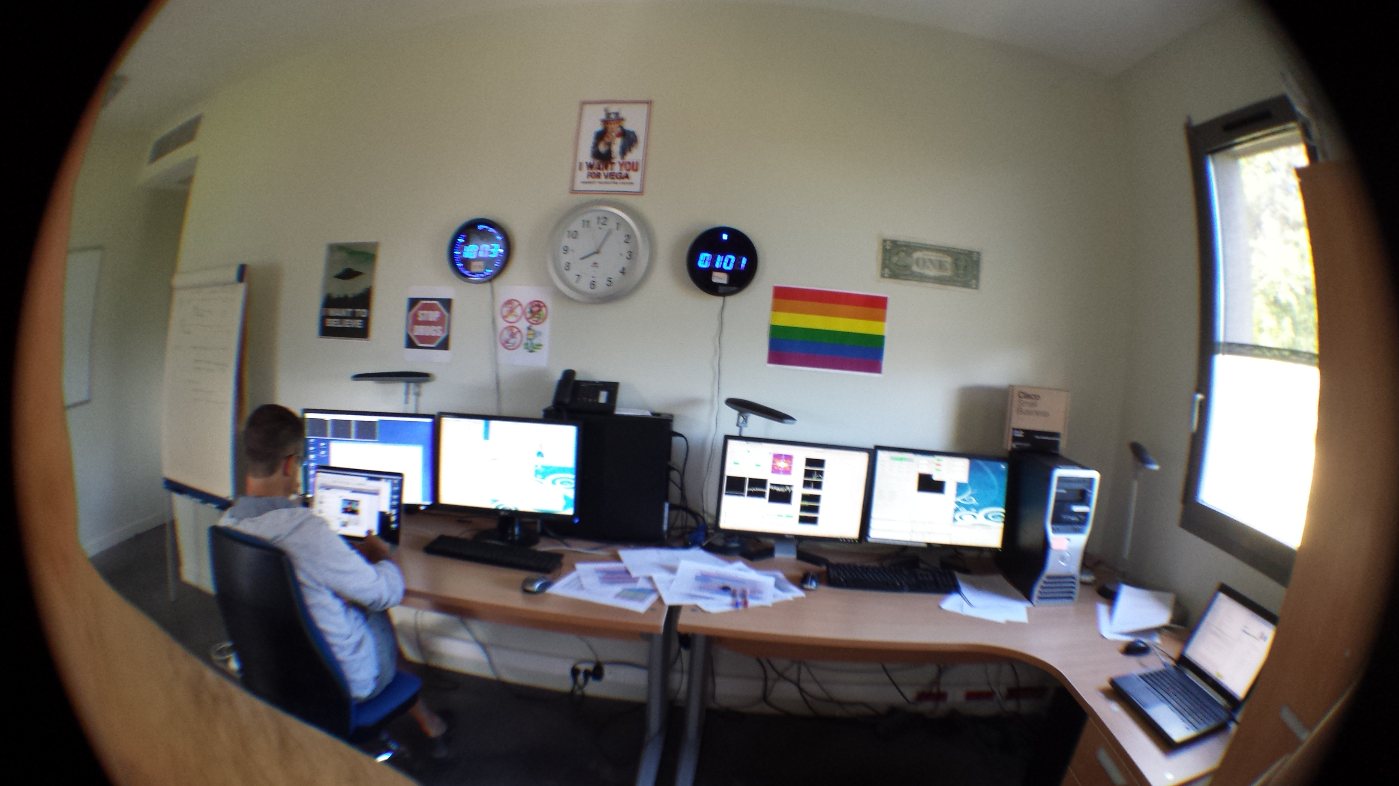
Overview and current state of the VEGA scientific programmes
Vega Control Room in Nice

Slide 2
What do we do with VEGA?
« Large Band » interferometry
Measure angular diameters
down to 0.2 mas
(highest spatial resolution)
But also study geometry
like binary, flatening…
But limited imaging due to lack of closure phase
and 2nd lobe V² measurements
Spectrally-resolved
interferometry
Study variation of visibility
and phase through
emission or absorption lines
Localize chemical elements
Study kinematics
Spectro-imaging
(thanks to differential phase)

Slide 3
I. Measuring angular diameters
Why?
Fundamental parameters of stars
Calibration of various
distance relations
Exoplanets host-stars
(calibration)

Slide 4
1. Fundamental parameters of stars
I. Measuring angular diameters
Physical processes like convection, rotation, magnetic fields, non-radial pulsations, etc. are based on fundamental parameters
  M⋆ , R⋆ , L⋆, T_{eff} , g_{eff} , ρ , abundances
From the measurement of these fundamental parameters and theoretical evolutionary tracks, one can put into test models
    Stellar interiors, evolutionary stages
    Magnetic field topology, pulsation excitation
    Planetary systems

Slide 5
1. Fundamental parameters of stars
I. Measuring angular diameters
Evolutionary
Models
Distances
(Parallaxes)
R⋆
Angular
Diameters
(interferometry)
Age
L⋆
M⋆
g_{eff}
T_{eff}
Bolometric flux
(Spectro-photometry)
Stellar interiors
Models

Slide 6
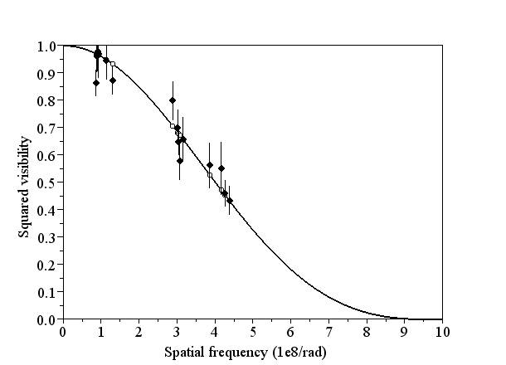
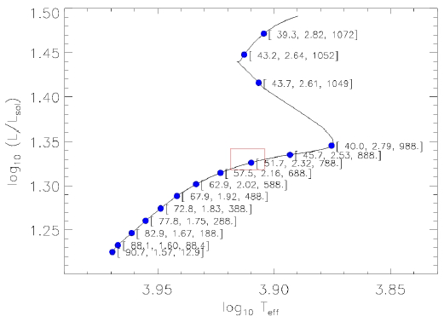
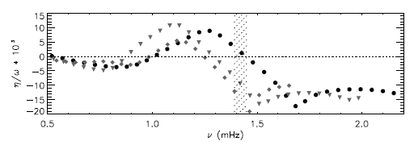
1. Fundamental parameters of stars
I. Measuring angular diameters
R = 2.317 ± 0.070 R
10Aql
Perraut+ (2013)
Smallest star
ever measured!
+ Bolometric flux and parallax
+ Large frequency separation Δν
+ Evolutionary track (CESAM2K)
↓
0.275± 0.006 mas
M = 1.95 ± 0.05 M
Oscillation modes models
[Perraut et al. A&A, 559, A21 (2013)]

Slide 7
1. Fundamental parameters of stars
I. Measuring angular diameters
ro Ap stars (Perraut)
  2 Papers published (Perraut+ 2011, Perraut+ 2013)
  New observations for 2014
COROT Targets (Creevey & Bigot)
  1 paper published (Bigot+ 2011)
  New observations for 2014
Subgiant stars (Mourard & Farrington )
  1 Paper to be submitted in 2014
Red giant stars ( Creevey & Bigot)
  1 paper in preparation
Metal-Poor (Bigot & Creevey)
  1 Paper to be submitted in 2014

Slide 8
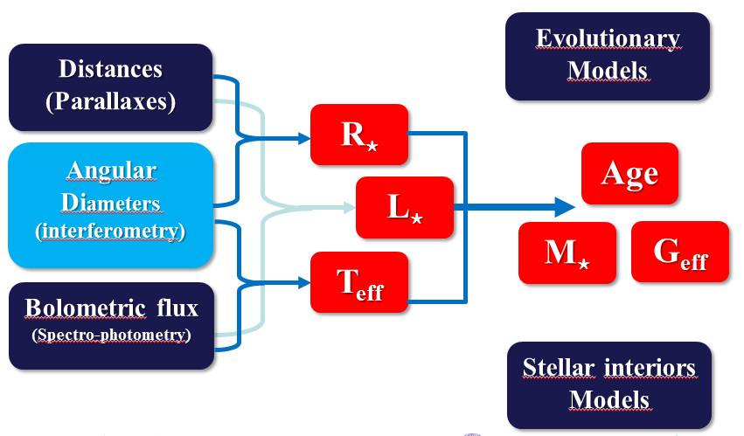
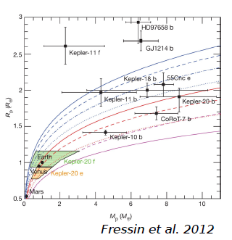
2. Exoplanets host-stars
I. Measuring angular diameters
Planet Radius and Mass
given as a ratio of
Host-star R⋆ and M⋆
Back to fundamental params. of star
First paper on 4 host-stars
Ligi, Mourard et al. (2012)
Ligi PhD thesis defended in 2013
Observation are going-on
2nd paper in preparation

Slide 9
3. Calibration of distance relations
I. Measuring angular diameters
The Araucaria Project and the VEGA/CHARA Instrument
Nardetto et al.
1
Cepheids
Comparing angular diameter from VEGA and FLUOR
Nardetto et al. in prep.
CEPHEIDS
SB relation and p-factor controversy
Better use of BW distances (MW and LMC)
2
Late-Type stars
large program including VEGA & FLUOR + PIONEER
paper(s) in preparation
ECLIPSING BINARIES
improvment of the SB relation (1%)
45 systems in LMC: distance at 1%
Observational cosmology Hubble constant to 2%
3
ECLIPSING BINARIES
Early-type stars
VEGA/CHARA observations of 8 stars
Challouf et al. submitted Challouf et al. in prep
many more systems discovered in nearby galaxies: e.g. M33 at 5%
improvment of the SB relation (5%)
Internal test on the λ tau Galactic eclipsing binary VEGA + MIRC Nardetto et al. in prep
transverse theme: the surface brightness

Slide 10
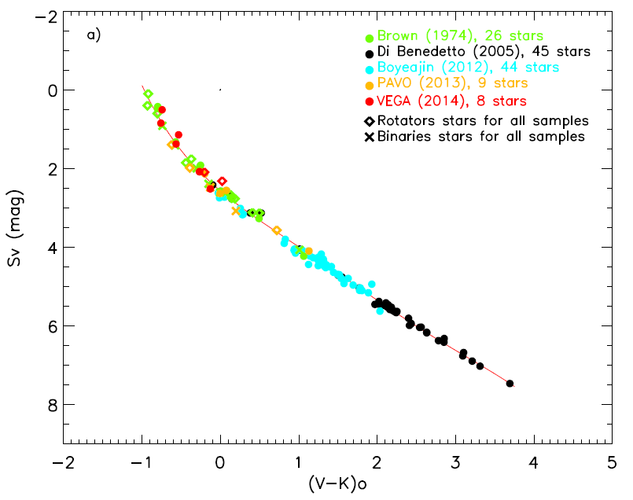
3. Calibration of distance relations
I. Measuring angular diameters
M. Challouf^{(1,2)} , N. Nardetto⁽¹ ⁾ et al. 2014, submitted
angular diameters of 8 early-type stars in the visible with a ≈1,5% accuracy
$S_{v}$ relation with 0,11 mag of accuracy ( 5% on predicted angular diameter )

Slide 11
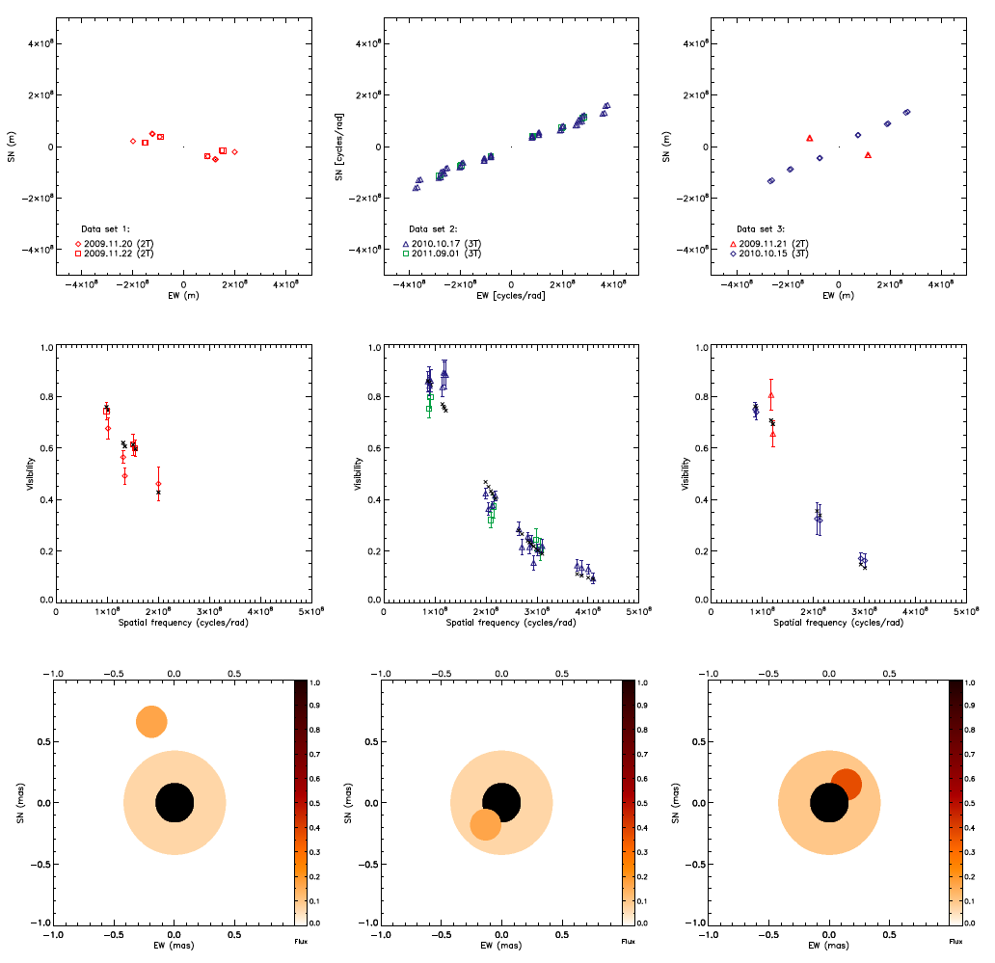
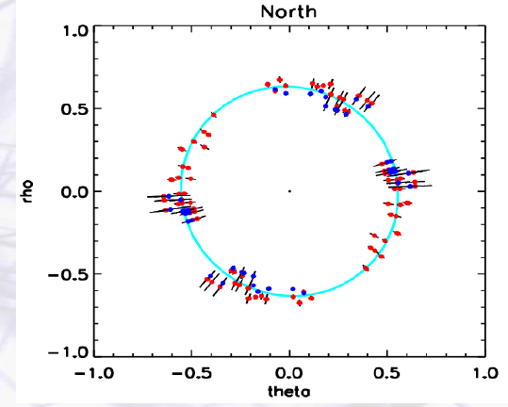
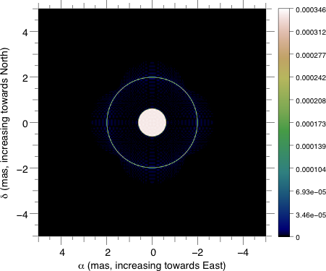
I Measuring angular diameters
4. Beyond diameters : binaries, environment, flattening…
Flatening of δ Per
Challouf+ in preparation
λ Tau eclipsing binary
Nardetto+ in preparation
extended environment around δ Cep
Nardetto+ to be submitted in 2014

Slide 12
II spectro-interferometry
1. Overview of published papers
11 papers (total VEGA papers = 20 – 3 technical ones)
9 papers on circumstellar environment
  Disk of Be stars (Delaa+ 2011, Meilland+ 2011, Smith+ 2012, Stee+2012)
  Disk and/or Wind of YSO (Peraut+ 2010, Benisty+ 2013)
  Interacting binary (Bonneau+ 2011)
  Wind of supergiants (Chesneau+ 2010)
  Peculiar stars (Mourard+ 2012)
2 papers on stellar surface or atmosphere
  Chromosphere of K giants (Bério+ 2011)
  Rotation of α Cep (Delaa 2013+)
5 papers with only geometry and/or extension (Hα, Hβ, CaII triplet, SiII, HeI)
6 papers with kinematics constraints (mainly in Hα)

Slide 13
II spectro-interferometry
2. Access to kinematics thanks to differential vis. and phase
The Be star Omi Aqr

Slide 14
II spectro-interferometry
2. Ongoing programmes
2013
  51 Oph (YSO?)
  θ1 Ori C (YSO binary)
  SS Lep (symbiotic YSO)
  β Lyr imaging (binary Be star)
  Be/Bn stars
  Stellar Spots
  Yellow Hyper Giants
  ε Aur
  P Cyg
  Nova Del
2014
  YSO CE (disk/Wind)
  Late YSO (51 Oph and HD141569)
  SS Lep (symbiotic YSO)
  Fast Rotation of Bn stars
  Edge on Be stars
  Magnetic Be stars
  YHG (evolution and eruption)
  Chromosphere of Red Giants
  ε Aur
  P Cyg
YSO
Be Stars
Other

Slide 15
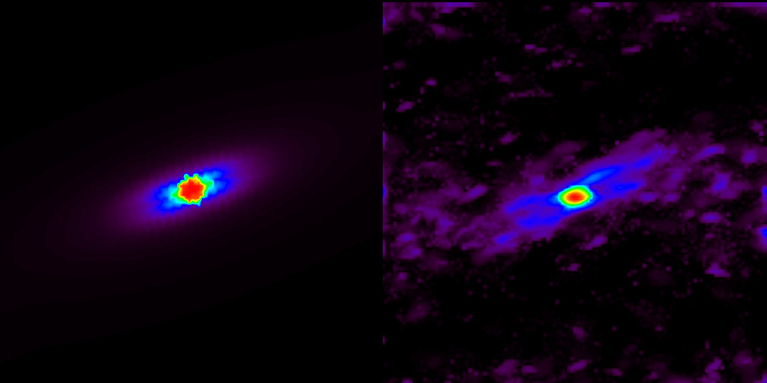
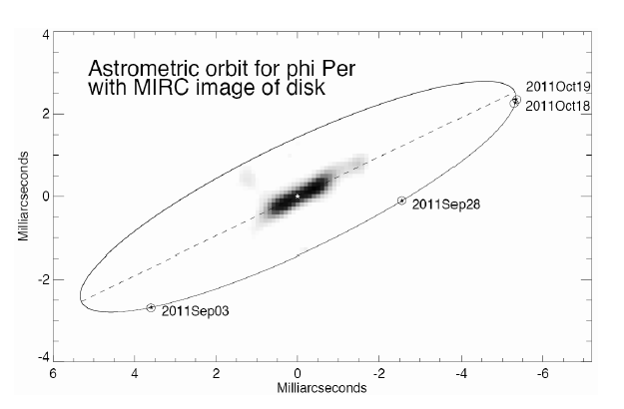
II spectro-interferometry
4. VEGA imaging capabilities
The circumstellar disk of
The edge Be star φ Per
Mourard, Monnier et al. 2014, in preparation
VEGA 4T
8 Observations (= 48 uv pts)
in the Hα line
R≈1600 (180 km/s)
+
MIRC 6T
Integrated image in the whole Hα line
MIRA software (Thiébaut) + self-calib algorithm (Millour)

Slide 16
II spectro-interferometry
4. VEGA imaging capabilities
Artifacts or not?
Some random model
at high inclination
using the BEDISK code
(A. Sigut & C. Jones)
Integrated image in the whole Hα line
MIRA software (Thiébaut) + self-calib algorithm (Millour)

Slide 17
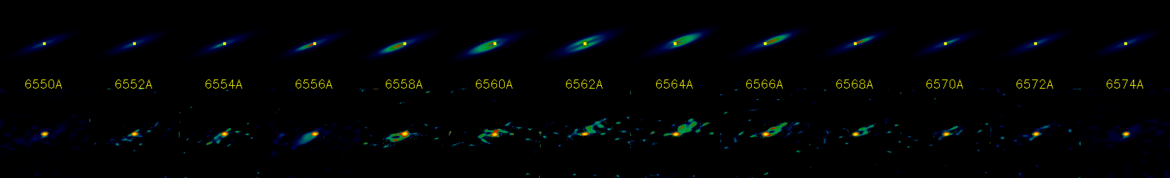
II spectro-interferometry
4. VEGA spectro-imaging capabilities

Slide 18
II spectro-interferometry
4. VEGA spectro-imaging capabilities
=
Integral-field spectroscopy
with a high spatial resolution

Slide 19
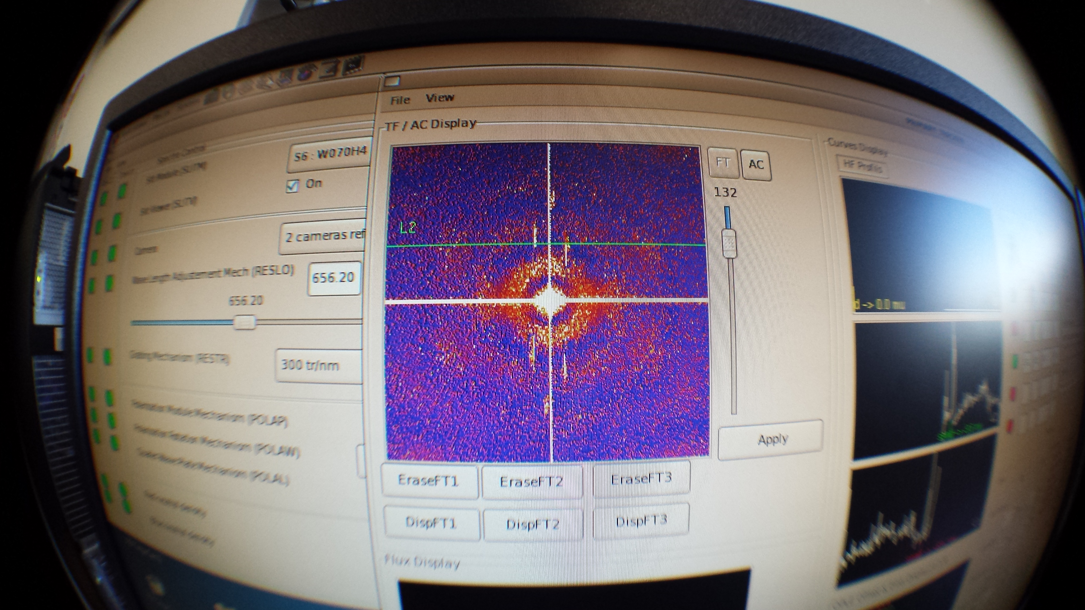
Merci CHARA et à bientôt!

