Slide 1
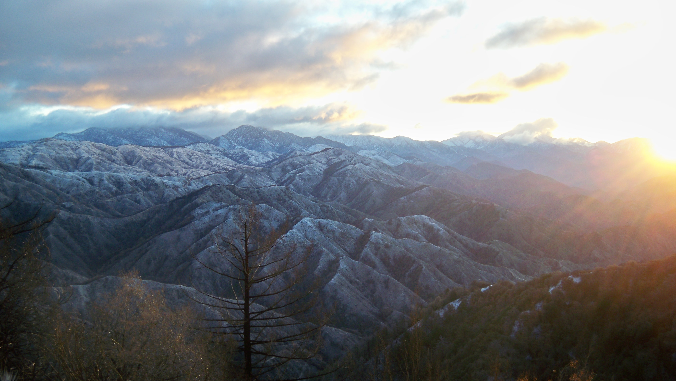
Programs and perspectives of visible
long baseline interferometry VEGA/CHARA
Near Mt Wilson
D. Mourard, N. Nardetto, R. Ligi and K. Perraut
OCA/FIZEAU (Nice) – UJF/IPAG (Grenoble)

Slide 2
Why measuring angular diameter?
See Cunha et al. (2007) A&A Rev. 14 & Creevey et al. (2007) A&A
θ (uniform disk) or θ (limb-darkened disk)
  Calibration of surface brightness relations (distances, ...)
  Constraint on stellar atmosphere models (teff, ...)
θ + π ➔ R, radius in m.
  Constraint on stellar evolution models (mass, age, ...)
  Constraint on asteroseismology

Slide 3
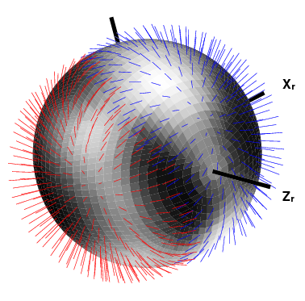
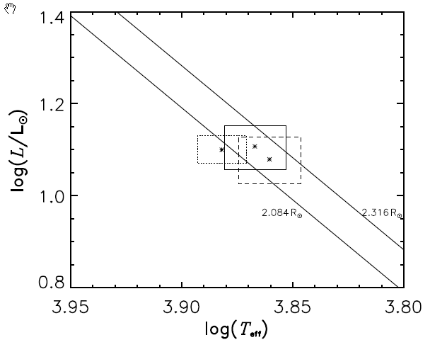
Constraint on stellar evolution models
Example: γ Equ, roAp star
VEGA/CHARA determination
Perraut et al., 2011, A&A 526, A89
Previous determination
Kochukhov & Bagnulo
VEGA determination without contamination by a companion (?)

Slide 4
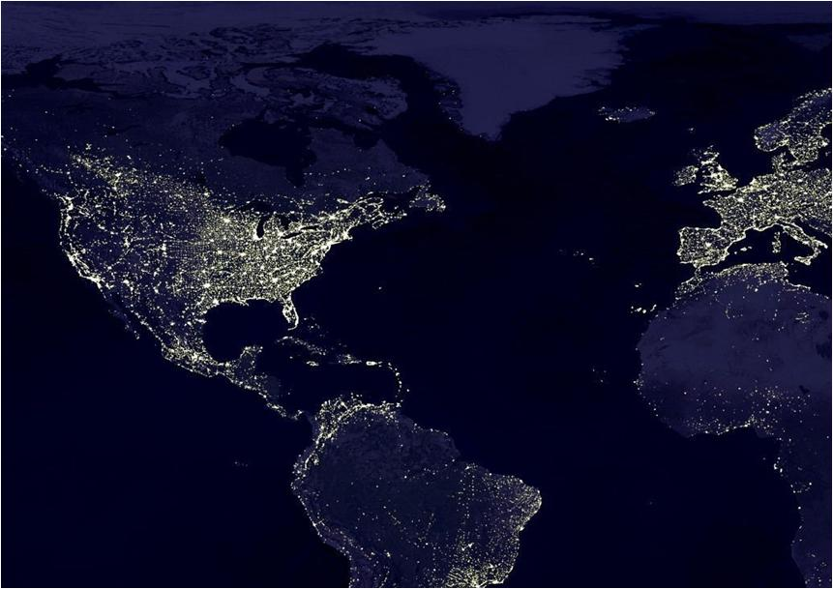
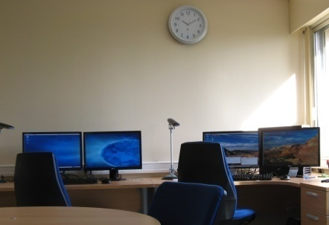
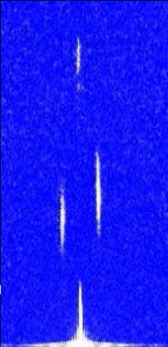
VEGA/CHARA High angular and spectral resolution
(0.3mas et R=6000/30000)
Apport de VEGA
Remote control
CHARA Array
09-2007: Integration
07-2008: First science light
10-2008: Mode 3T
07-2009: Remote operation
06-2010: First science papers
10-2010: Mode 4T
08-2011: 11 papers in total (2 technical)
2011 :
3T VEGA + IR instruments (CLIMB, MIRC)
30 programs, 50 nights per year
Collaboration through VEGA team
Mode 3T
Mode 4T
Notes:
Héritage du savoir-faire développé sur le GI2T, l’nstrument VEGA/CHARA a été installé en septembre 2007 et les premières observations scientifiques ont eu lieu pendant l’été 2008.
Depuis l’été 2009 il peut être opéré à distance depuis une salle de téléobservation installée à Grasse et maintenant Nice et financée par la Région PACA et le CNRS. (9 heures de décalage horaire, soit des “nuits” en france de 3h à 15h environ)
VEGA/CHARA permet des mesures absolument uniques au monde en alliant une très haute résolution angulaire (300m de base dans le visible soit mieux que 0.3mas) et spectrale ( résolution de 6000 et 30000).
Depuis peu l’instrument est capable de fonctionner en routine en recombinant 3 télescopes simultanément et en octobre 2010, VEGA a réussi pour la première fois en France la recombinaison simultanée de 4 télescopes, ouvrant de grandes perspectives pour l’imagerie des surfaces stellaires.
Entre le mois de mai 2010 et janvier 2011, 5 articles à comité de lecture ont été publiés sur les résultats scientifiques obtenus. Plusieurs autres sont en préparation et de nombreux programmes originaux sont maintenant abordés par l’équipe. Un dossier d’ANR sur l’étude des bruits stellaires pour les étoiles hote d’exoplanètes a été déposé.
Les études spectrales différentielles sont fortement développés par l’équipe scientifique ainsi que des études tout à fait originales sur les paramètres stellaires fondamentaux.

Slide 5
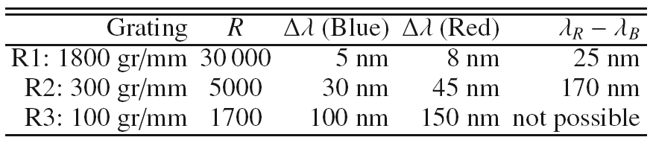
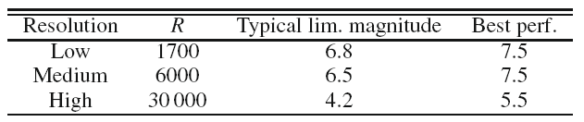
Summary of performances
Mourard et al. A&A 2009, 508 (for 2T) & Mourard et al. 2011, 531 (for 3T/4T)
Spectrograph Characteristics
Limiting magnitude
R0=8cm
R0=15cm
Notes:
The detailed principle of the instrument has been published in A&A last december.
The main characteristics of VEGA in terms of performances are described in this publication as well as the main steps of the data reduction procedure.
Classical V² and complex differential visibilities are deduced from the short exposures images recorded by the two photon counting detectors.
The main and most important results are the good number in terms of limiting magnitude. The instrumental visibility, now estimated through the statitics of short sequence measurements, has been characterized to be stable over period of hour when seeing conditions are stable enough. A relative accuracy of 2% on calibrated V² is usually reached under good seeing conditions.
Concerning differential phase measurements, a residual noise of 1 to 2° is obtained, delivering an astrometric precision better than 100 times the angular resolution of the baseline.
One should also note that VEGA is able to operate with three telescopes. V² measurements in 3T mode have been correctly characterized. Preliminary results on closure phase (on calibrators only) have been obtained showing a stability of about 2°. We will come back later on this 3T operation.

Slide 6
Summary of the VEGA Science Programs http://www-n.oca.eu/vega/en/publications/index.htm
Fundamental parameters
  roAp stars: Perraut et al., A&A 526 (2011)
  CoRoT Targets: HD49933: Bigot et al., A&A (2011), in press
  Exoplanet host stars, 13 Cyg
  Sub giants radii and orbits (class IV stars)
  Eclipsing Binaries
Circumstellar environments (using generally the spectral resolution of VEGA)
  AB Aur (disk): Perraut et al, A&A 516 (2010)
  A/B Supergiants (wind): Chesneau et al, A&A 521 (2010)
  β Cep (disk): Nardetto et al. , A&A 525 (2011)
  Be stars (wind): Delaa et al. A&A 529 (2011)
  Ups Sgr & Bet Lyr (Interactive massive stars): Bonneau et al., A&A 432 (2011)
  δ Sco (Interactive massive stars): Meilland et al. A&A 532 (2011)
  The chromosphere of K giants: Berio et al. A&A (2011) in press
  Eps Aur (co-rotating disk eclipsing the central star)
  Young Stellar objects (MWC361, AB Aur, ...)
  Rotation of stars and interaction with environment
presented in this talk
presented in this talk
presented in this talk
Notes:
Short presentation of the main science programs currently under investigation with VEGA:
Results already accepted for publication (see detailed presentation just after). Demonstration of « faint » object science and strength of high spectral resolution (30000).
« Classical » studies with VEGA in medium spectral resolution and using the Halpha +Hbeta spectral lines
V² measurements and consequences on prototypes of some stellar classes. Start of observing programs on ‘large’ samples in a same class of stars.
Finally: some programs on important hot targets as well as complementarity programs with VLTI and CHARA-IR.

Slide 7
HD49933
Bigot et al., A&A (2011), in press
Observations october, 16th 2010
  Calibrations stars: C1 = HD55185 and C2 = HD46487
  Direct measurement of C2: θ_{UD} = 0.474 ± 0.014mas
θ_{LD,HD49933} = 0.445±0.012mas
→
R = 1.42 ± 0.03 R

Slide 8
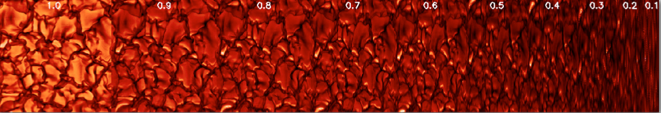
3D radiative and hydrodynamical modeling
Bigot et al., A&A (2011), in press
Intensity profile @730nm : μ = 1.0 (disk center) à 0.1 (limb).
Cells of 21000 × 21000 km.
Radiative and hydrodynamical code (STAGGER CODE, Nordlund & Galsgaard, 1995)
Simulation of the surface convection and of the atmosphere stratification.
Global fitting of the evolution model taking into account the CoRoT frequencies (small and large separations) AND the angular diameter
See also the poster by Kervella et al.

Slide 9
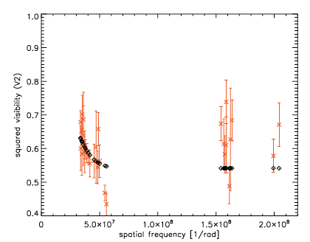
The close environment of β Cep
4 models tested:
1: star + Gaussian (χ^2= 2.5)
2: star + circular ring (χ^2= 1.5)
3: star + Gaussian + companion at 170 mas (χ^2= 2.5)
4: star + co-rotating disk (χ^2= 0.9)
S1S2
W1W2
Magnetically confined wind-shock model
Favata et al. (2009)
star + Gaussian
Notes:
Spectral type: A9p
Magnitude: V = 4.7
V sin i ~ 10 km/s
Parallax π = 28.38 mas
Distance = 35 pc

Slide 10
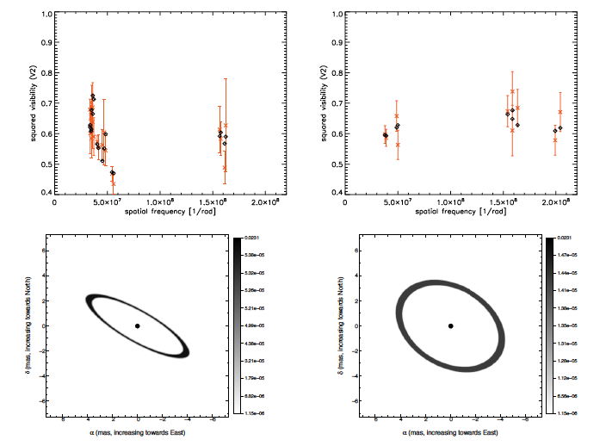
β Cep close environment : co-rotating disk
Nardetto et al. A&A, 2011, 525, 67
t1
t2
(Porb=12j)
Conclusion : a large scale structure contributing to 22% of the flux is detected
new observations 3T and 4T : 46 VEGA + 36 MIRC (IR) = 82 in total
Constraints on the angular diameter for asteroseismology
Notes:
Spectral type: A9p
Magnitude: V = 4.7
V sin i ~ 10 km/s
Parallax π = 28.38 mas
Distance = 35 pc

Slide 11
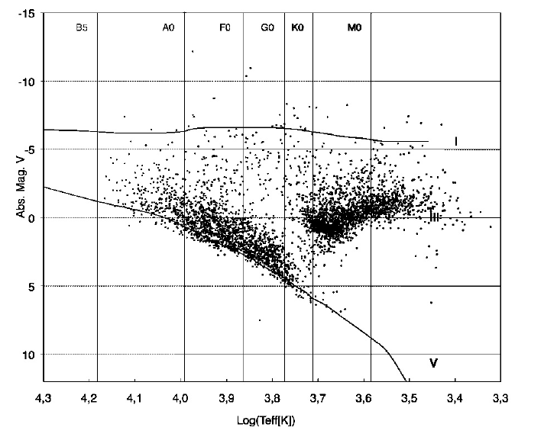
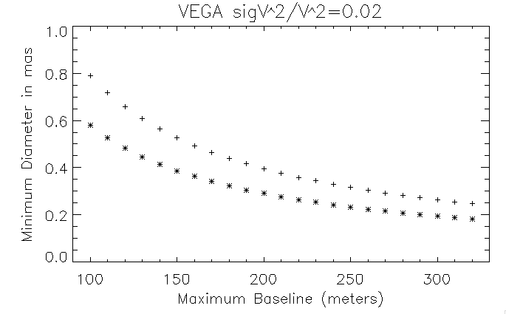
Perspective : fundamental parameters
Need a external IR fringe tracker
1%
2%
The angular diameter of 4000 stars with magV<6.5 can be measured with a relative precision of 2% (see Mourard et al. 2011, A&A, 531)

Slide 12
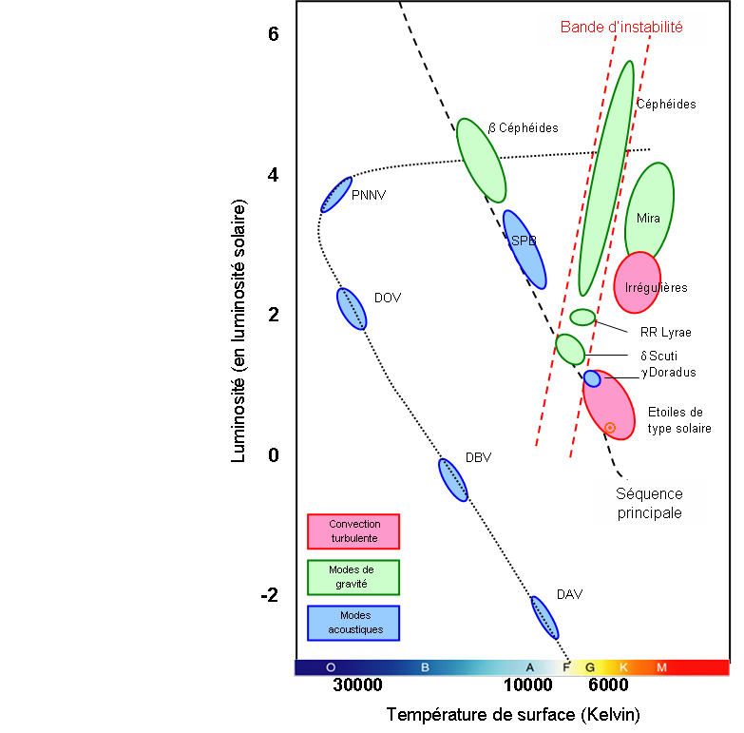
Perspective : pulsating star / asteroseismology
1- distances IBW : Cepheids + HADS
2- asteroseismology : Solar types/γ Dor/δ-Scuti/RR Lyrae/RoAp/β-Cepheides
3- environment : β-Céphéides, ...
1-
Δθ (φ)
3-
<θ> et CSEs
Luminosity)
2-
<θ>
Temperature (K)

Slide 13
Main VEGA programs for the future
Characterization of exoplanets host stars
  Limb darkening measurement
  Spots detection and characterization
    Consequences for transit and RV
    Impact on planet’s parameter of the ‘stellar noises’
Angular diameters and Limb Darkening across the HR diagram
  ➔ Towards calibrated fundamental laws as input of stellar evolution models

Slide 14
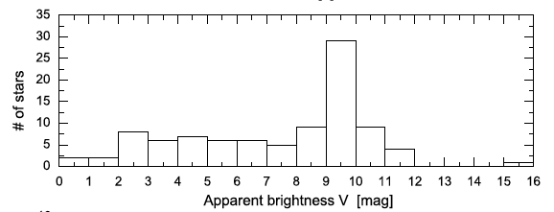
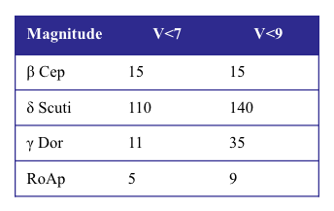
Pulsating stars (need AOs + external fringe tracker):
1/ angular diameter variation (distances):
2/mean angular diameter (asteroseismology) :
Magnitude | V<7 | V<9
Cepheids | 20 | 40
W Vir | 0 | ?
RR Lyrae | 0 | ?
HADS | 0 | 3
θ>0.3mas
β Cep
PL1
PL2
θ>0.2mas (variation?)
(δ > -30°)
Fernie et al. 1995
MacNamara et al. 1997
θ>0.2mas
θ tbd
θ tbd
Precision and exactitude of 0.01 on the PL relations (5% on Ho)
θ < 1 mas
Garcia et al. 1995
Stankov et al. 2005
Matthews et al. 1999
CGVC

Slide 15
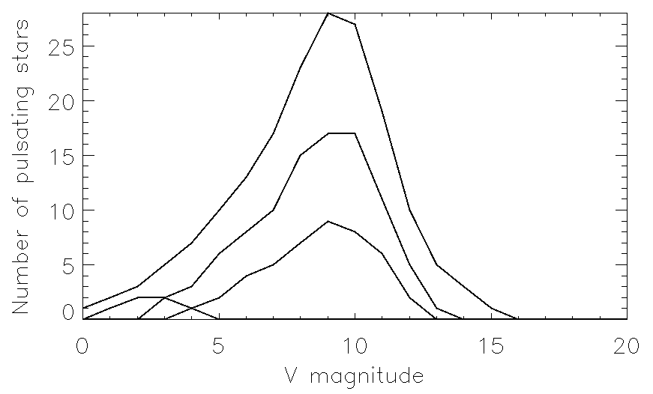
Pulsating Binaries (need AOs + external fringe tracking)
3/ masses (binaries)
Zhou 2010 (δ > -30°)
182 : total of pulsating binaries
100 : Cepheids
49 : δ Scuti
10 : β Cephei
3 : SPB
12 : DBV
4 : “Solar Like” Pulsators
4 : γ-Dor
number of pulsating
binaries
<V> magnitude
Magnitude | V<7 | V<9
Pulsating Binaries | 45 | 85
Bias by flux ratio and separation
Note : eclipsing binaries are now used to determine the distance of LMC.
VEGA can calibrate the method observing Galactic eclipsing binaries (programs in progress)

Slide 16
Science drivers
mass loss
pulsation period
rotation period
magnetic field
angular diameter
separation (binarity)
mass (1-2%)
radius (1-2%)
distance
VEGA MR/HR
VEGA LR/MR
effective temperature (+/-50K)
luminosity (5-10%)
surface gravity
mean density
abundances
Physics of stars
Evolution Models
Position in HR diagram
Notes:
The stellar atmospheric parameters of effective temperature and surface gravity are of fundamental astrophysical importance. They are the prerequisites to any detailed abundance analysis. As well as defining the physical conditions in the stellar atmosphere, these parameters are directly related to the physical properties of the star; mass, radius and luminosity. Model atmospheres are our analytical link between the physical properties and the observables - flux distributions and spectral line profiles. We can obtain effective temperature and surface gravity from suitable observations, assuming of course that the models we use are adequate and appropriate.

Slide 17
L’ environnement de β Cep : perspectives
Nouvelles observations 3T et 4T (fin 2010) :
46 mesures VEGA + 36 mesures MIRC = 82 mesures au total
-> 4S1S2, 10 E1E2 (vega) + 5 E1E2 (mirc) :
suivi sur 3 nuits (forme de l’anneau)
-> 8 W1W2 (vega), 8 W1W2 (mirc) + 26EW (vega) + 40EW (mirc) : contraintes sur le diamètre angulaire à 2 ou 3% probablement.
Bases trop longues pour faire des images
D’autres cibles β céphéides potentielles :
env. 7 étoiles avec V<7 et θ > 0.2 mas

Slide 18
Contexte
Groupe scientifique VEGA (OCA, LAOG, CRAL) très actif. Nombreux programmes scientifiques en cours et activité importante de publications
Environ 50 nuits par an dont de plus en plus de remote
Ouverture plus large de l’instrument
  Nombreuses demandes nationales et internationales
  Ouverture de CHARA via les appels NOAO
Consolidation du mode VEGA + IR
  CLIMB
  MIRC
  Fringe tracking et Programmes simultanés
  Amélioration considérable de la qualité des données

Slide 19
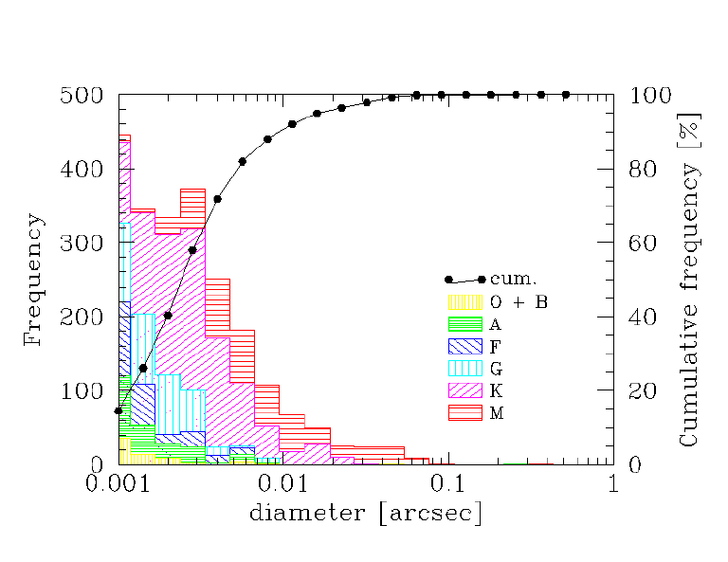
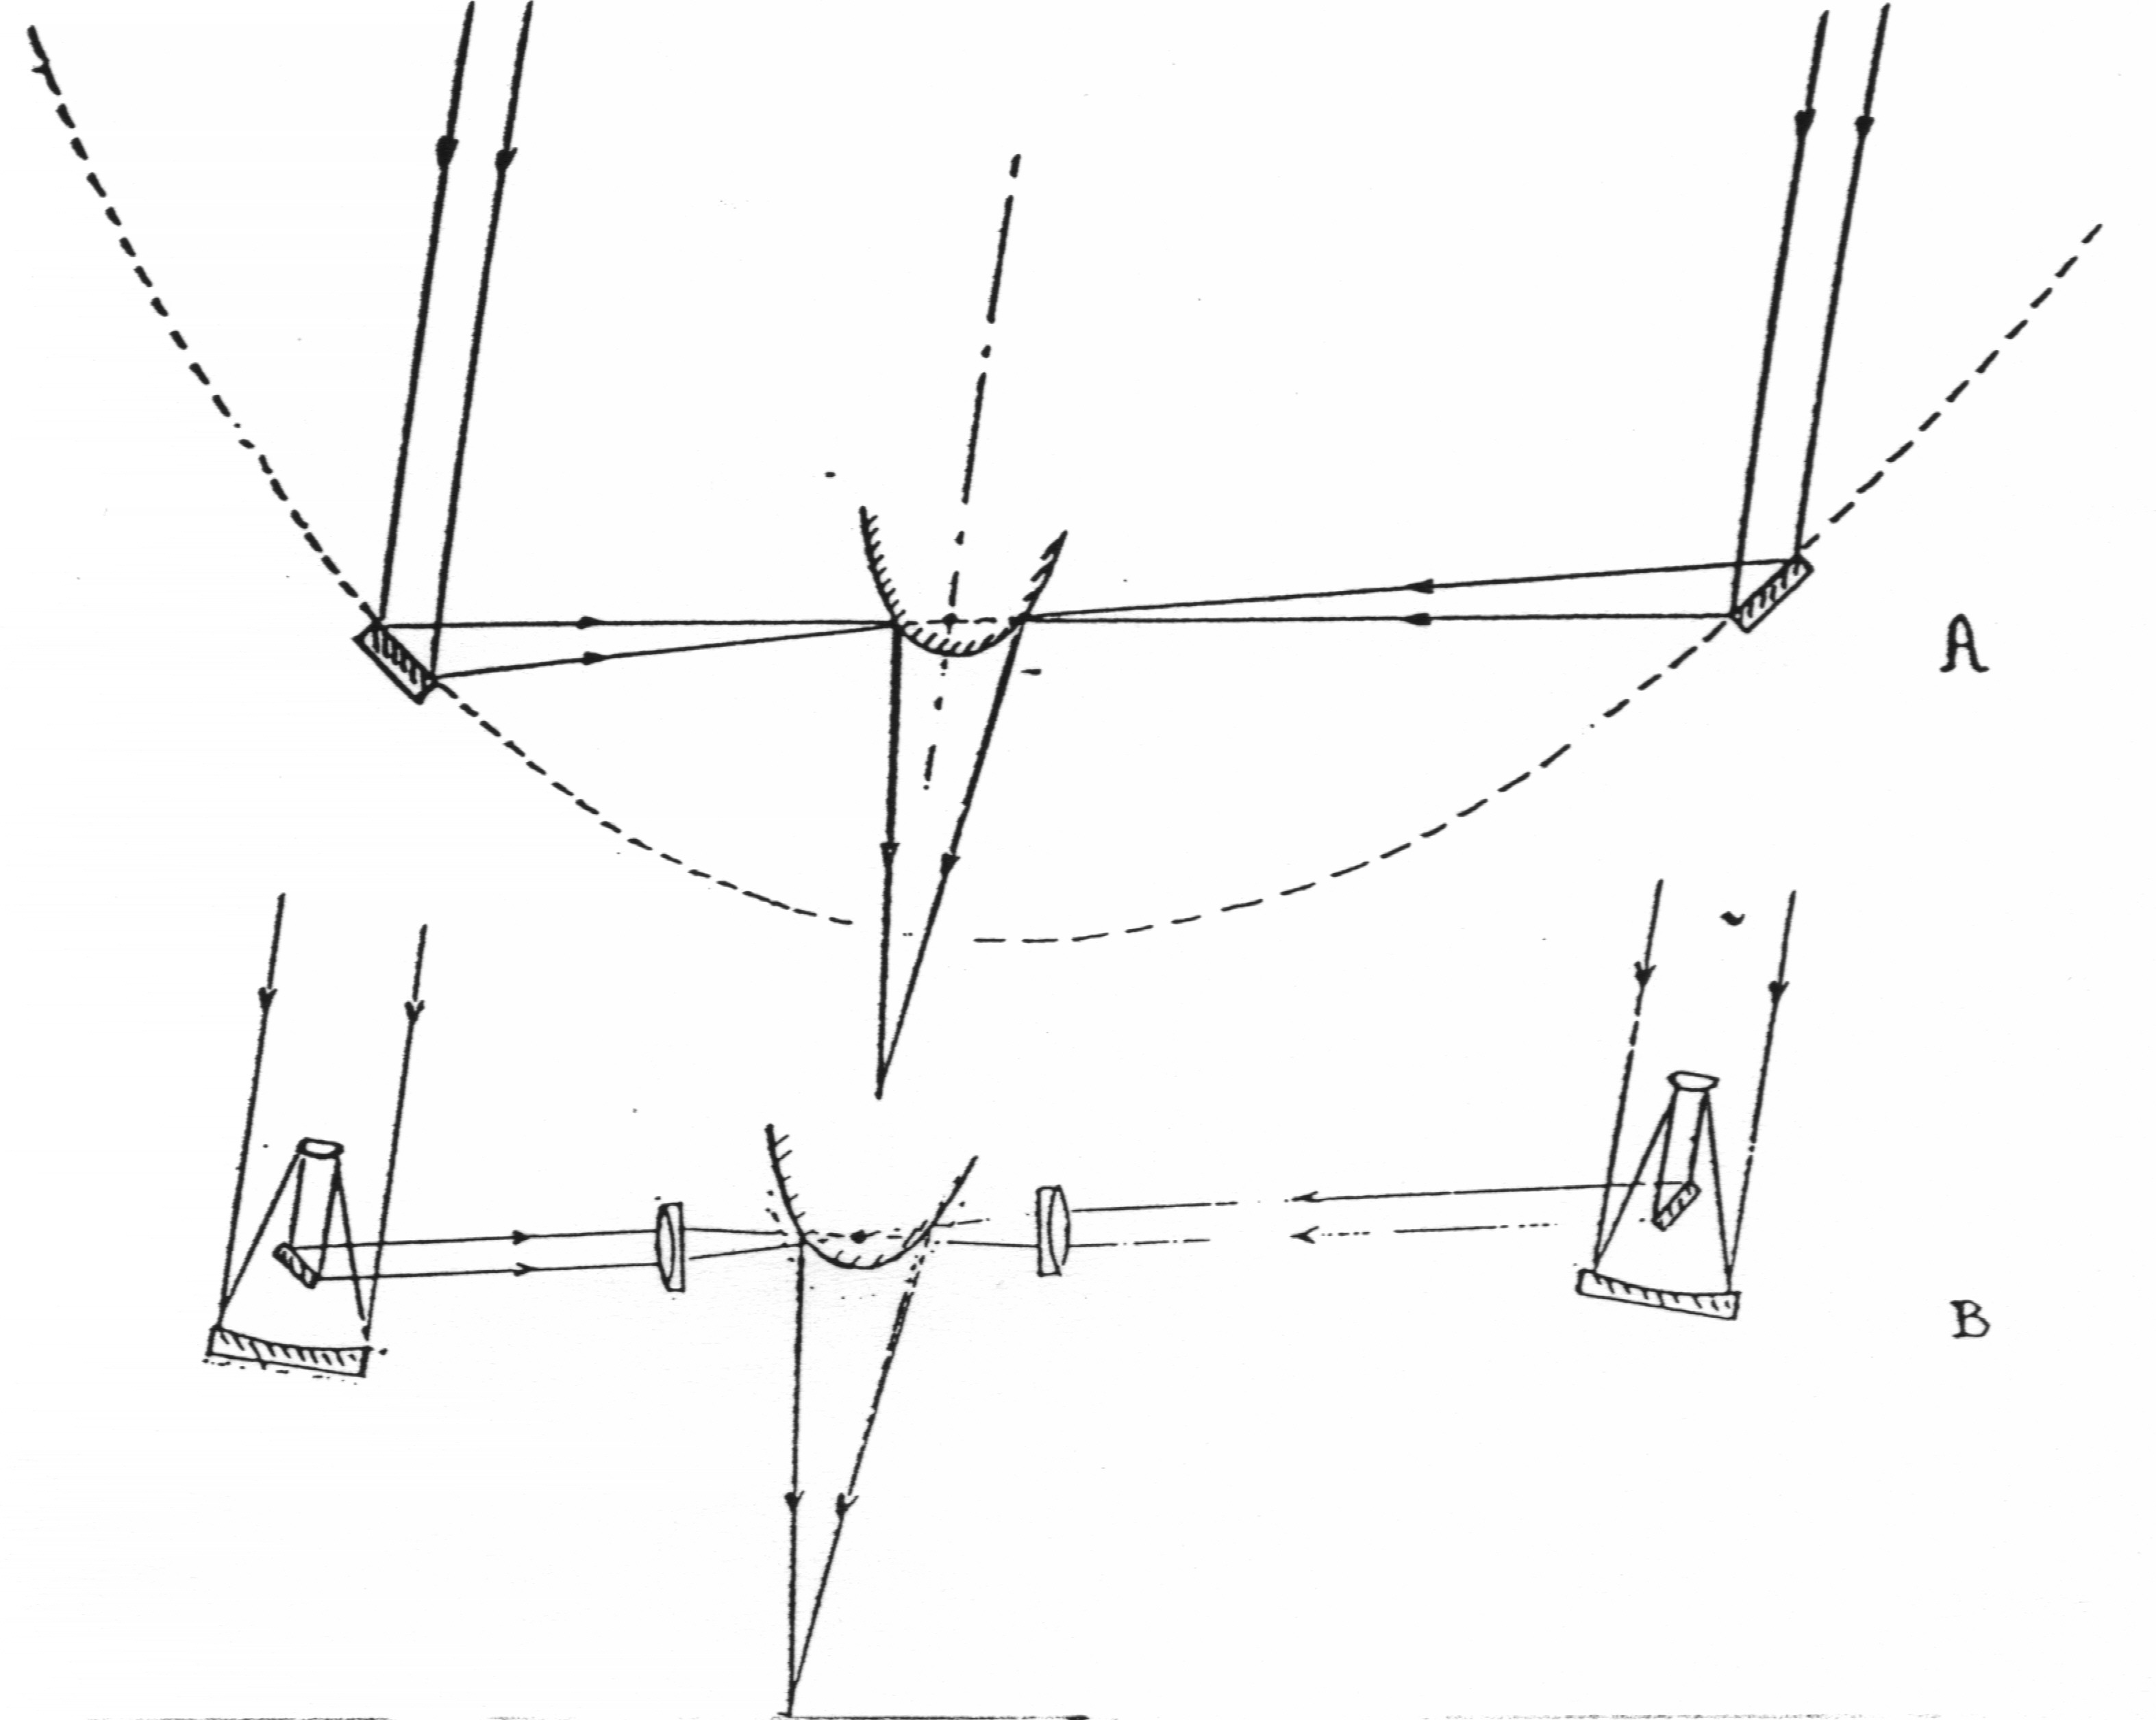
How to measure angular diameters?
1309 sources
50 % < 2.5 mas
20 % > 5 mas
7% > 10 mas -> UT
Angular resolution of a telescope: λ/D
Angular resolution of an interferometer: λ/B

Slide 20
Main VEGA programs for the future
Conclusion

